Slide 1

CSCI-3753: Operating Systems Spring 2021
Biljith Thadichi
Department of Computer Science University of Colorado Boulder
Slides based on presentation by Abigail Fernandes

Slide 2
Programming Assignment 2
2

Slide 3
PA2 – Character Device Driver
Programs
User Space
Open, Read, Write, Close, Seek
Device File (/dev/<name>)
mknod –m <permission>
<device_file_location>
<type of driver>
<major number>
<minor number>
File Operations
Device Driver
<name>
<major>:<minor>
<minor>
Kernel
Physical Device
3

Slide 4
PA 2
Create a Device File for Device
Create a Device Driver Module (LKM)
Implement file operations (open, seek, read, write, release)
Make and load the module
Test program that will allow you to perform different operations on the test file. (Done)
4

Slide 5
Creating Device File for a Device Driver
sudo mknod -m <permission> <device_file_location> <type_of_driver>
<major_number> <minor_number>
Ex. sudo mknod -m 777 /dev/simple_character_device c 240 0
5

Slide 6
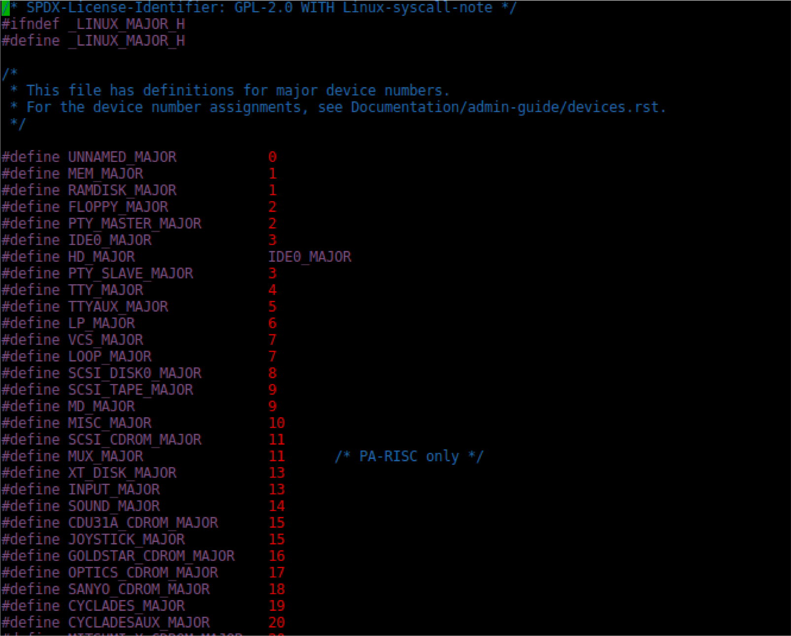
System Device Major Numbers
vim /home/kernel/linux-hwe-4.15.0/include/uapi/linux/major.h
6

Slide 7
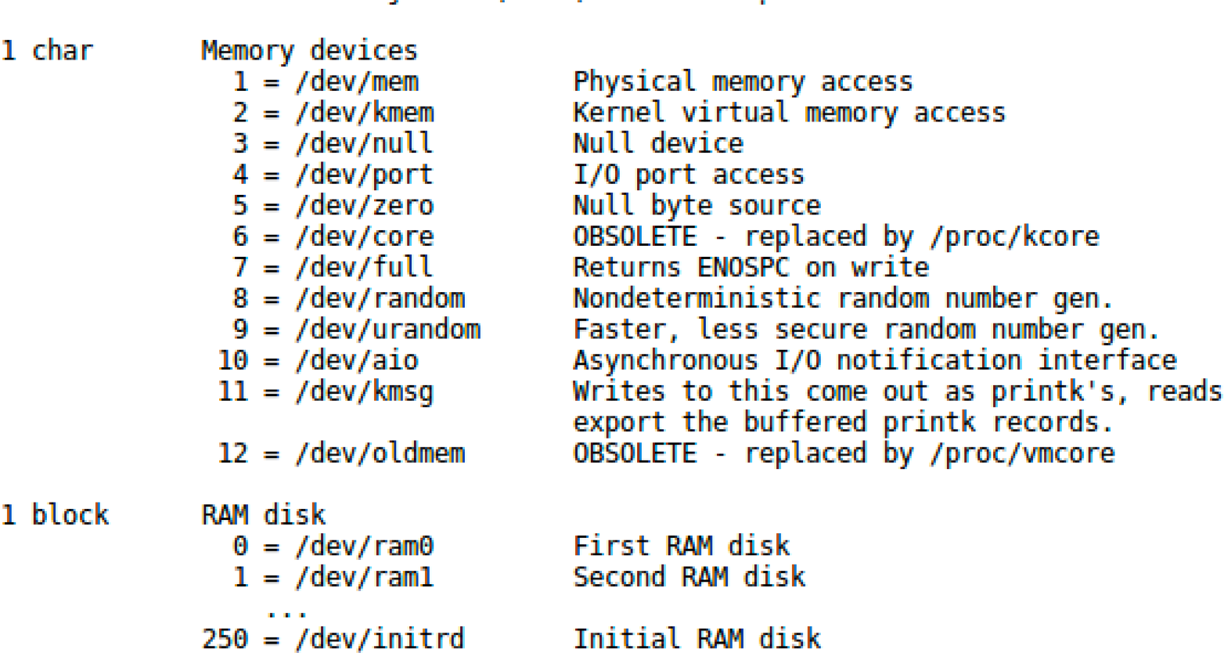
Documentation for devices
See Documentation/admin-guide/devices.txt -> Current devices and major numbers
vim /home/kernel/linux-hwe-4.15.0/Documentation/admin-guide/devices.txt
7

Slide 8
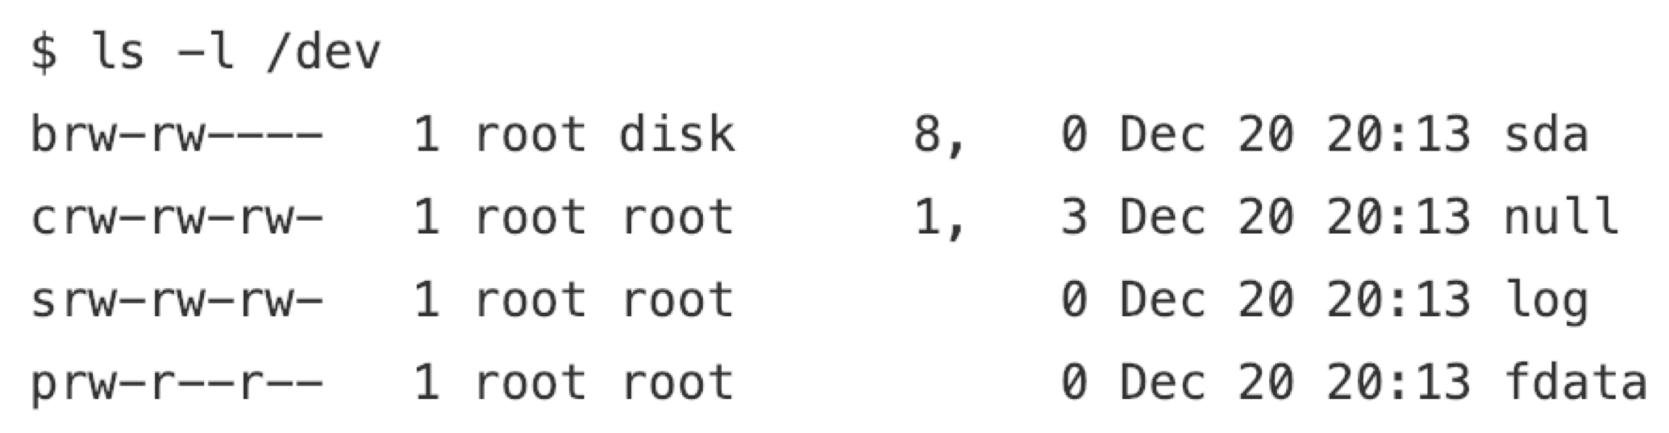
/dev Directory
Device Type
Permissions
Owner
Group
Major Device Number
Minor Device Number
Timestamp
Device Name
8

Slide 9
register_chrdev()
Major number
Unique name
Pointer to file operations struct
9

Slide 10
File Operations Data Structure
Defined in /linux/fs.h
vim /lib/modules/$(uname -r)/build/include/linux/fs.h
The kernel uses the file_operations structure to access the driver’s functions
Each field in the structure must point to the function in the driver that implements a specific operation, or be left NULL for unsupported operations.
10

Slide 11
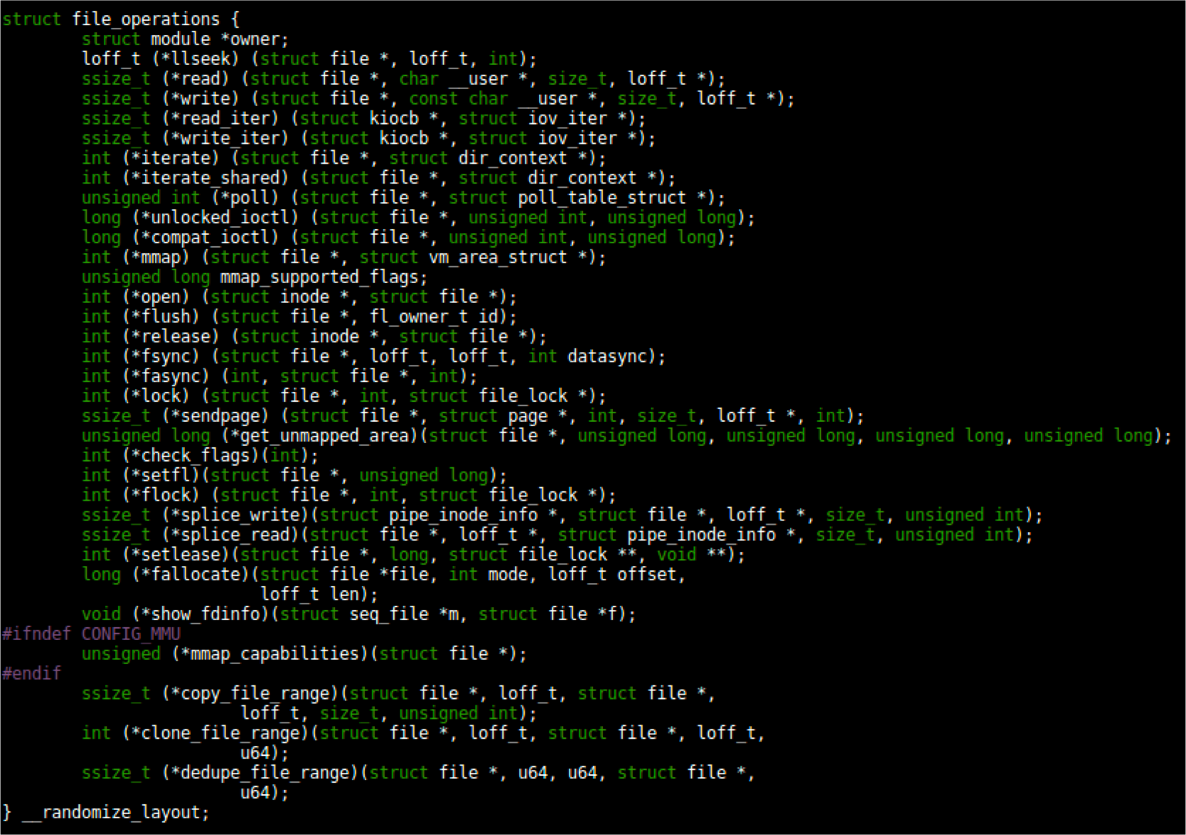
File Operations Data Structure
11

Slide 12
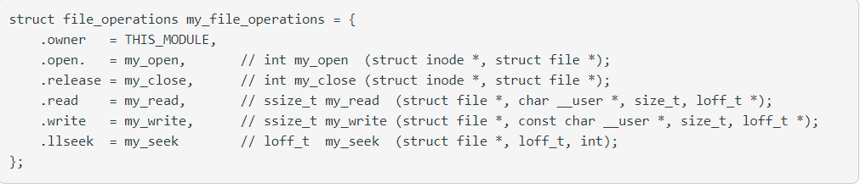
File Operations Data Structure
12
Notes:
Designated initializer

Slide 13
PA2 – Requirements
Dynamically allocate kernel buffer to store the data written by the user
kmalloc()
Allocate memory for objects smaller than page size in the kernel at initialization time
kfree()
Free memory previously allocated using kmalloc() before exiting
Offset pointer in read/write function
Use copy_to_user and copy_from_user inside the device driver.
13

Slide 14
Week 4 – Checklist
Complete Weekly Quiz
Start PA2 part B/C
Have a great Weekend!
32

